Slide 1

Cloud-Driven Transformation
NextGen Runner
Joby Pooppillikudiyil Jul.18.2024

Slide 2

AGENDA
Basic Pipeline Concept
Requirements
Reference Architecture – CI/CD
Diff. Teams Involved
Demo
General Tasks

Slide 3




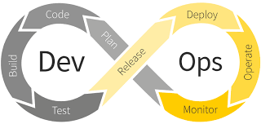
Basic CICD pipeline
1
2
3
Create Repo
Apply Github Actions Workflow
Deploy to Cloud

Slide 4
Requirements - Generic Solution
LargeCorp - Dennis
MidCorp
Programming Language: The project can be developed in any language (e.g., Python, Node.js).
Java Version:
Version: The build should support any Java version (e.g., Java 17, 21, 22, etc.).
Build Method: The build should support any build method (e.g., Maven, Gradle, etc.).
Branching Strategy: Any branching strategy can be used.
Stages: The pipeline should support any number of stages (e.g., Development, Pre-Production, Production, Hot-Fixes, etc.).
Repository Structure: Any repository structure should be supported, including
A single repository containing all services.
A 12factor methodology implementation.
CI/CD Reusability:
Existing GitHub Actions or workflows can be reused or partially reused.
Existing GitLab runners can be reused or not, as needed.
Versioning
Image versions

Slide 5






Reference DevOps Architecture – CI/CD
Open Container Initiative (OCI)
Repository
Container Registry
Kubernetes Cluster
3. Build Project (eg. Maven build)
4. Create and Push Docker Image
7. Get and Deploy latest image to the cluster
Deployment
5. and Push BuildHelm Chart
1. Commit Code With a Dockerfile
ArgoCd
Git Repo
2. GitHub Action Trigger Pipeline
Custom Runner
6. Update Kuberntes Manifest by updating ArgoCd application
SonarQube Dora
DynaTrace ImageScan
CI
CD

Slide 6
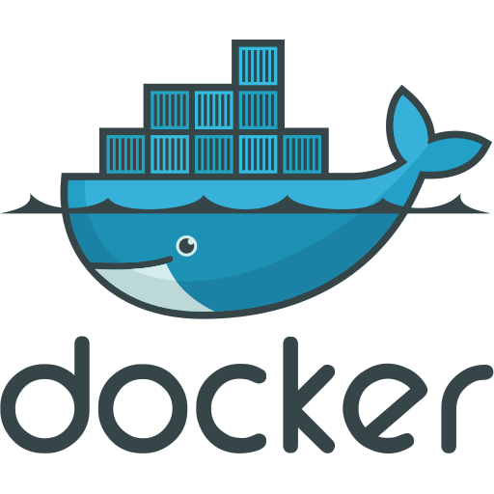

Reference DevOps Architecture – CI/CD
GitHub Runner Container
DinD Container
Volume mount
Ephemeral Storage
Volume
Docker Socket : /var/run
Runner Scripts : /home/runner/actions-runner/scripts
Customize Folder: /home/runner/actions-runner/scripts/customize
Persistent Storage
Maven Cache : /home/runner/.m2
Trivy Cache : /home/runner/.trivy
: /home/runner/.cache
Build Tools : /buildresources
NFS/EFS

Slide 7

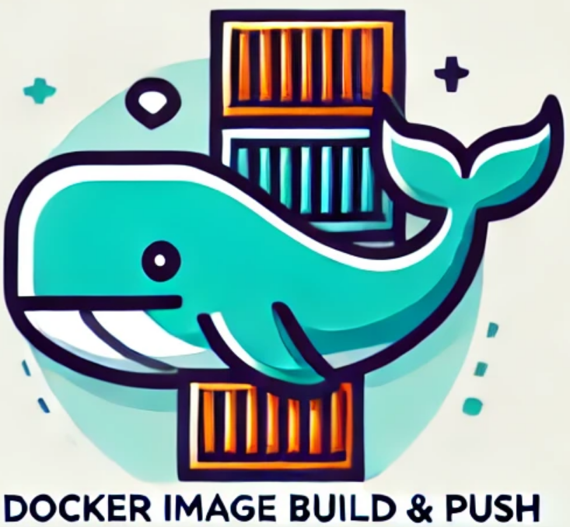


Basic CICD pipeline
build_deploy
build
deploy
Artifacts Build
Docker Build
Helm Build
Kubernetes Deploy
build_artifacts
docker_build_push
helm_build_push
kubernetes_deploy
retag_deploy
1
2
3
4

Slide 8
Basic CICD pipeline
build_deploy
build
deploy
Artifacts Build
Docker Build
Helm Build
Kubernetes Deploy
build_artifacts
docker_build_push
helm_build_push
NAMESPACE DOCKER_IMAGE_PUSH_PREFIX APPLICATION_NAME IMAGE_TAG
kubernetes_deploy
retag_deploy
DOCKER_IMAGE_PUSH_PREFIX APPLICATION_NAME IMAGE_TAG NAMESPACE
DOCKER_IMAGE_PUSH_PREFIX APPLICATION_NAME IMAGE_TAG
1
2
3
4
IMAGE_PULL_TAG DOCKER_IMAGE_PUSH_PREFIX APPLICATION_NAME IMAGE_TAG

Slide 10
Development
DevOps
Platform Team
1
Framework user
2
Framework customization
3
Framework setup
Open Container Initiative (OCI)
Repository
Container Registry
Kubernetes Cluster
3. Build Project (eg. Maven build)
4. Create and Push Docker Image
7. Get and Deploy latest image to the cluster
Deployment
5. and Push BuildHelm Chart
1. Commit Code With a Dockerfile
ArgoCd
Git Repo
2. GitHub Action Trigger Pipeline
Custom Runner
6. Update Kuberntes Manifest by updating ArgoCd application
SonarQube Dora
DynaTrace ImageScan
CI
CD

Slide 11
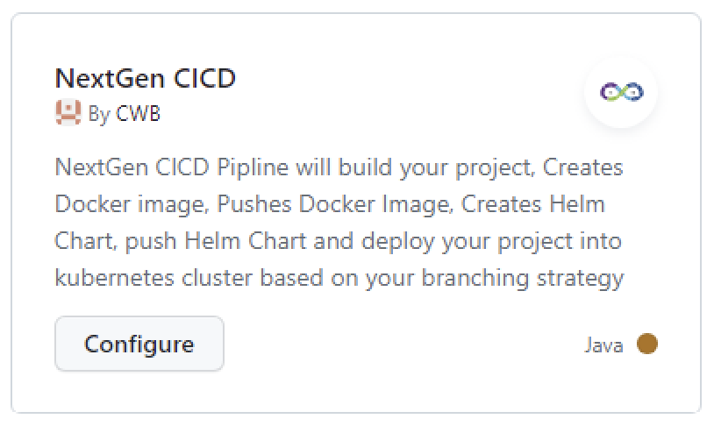
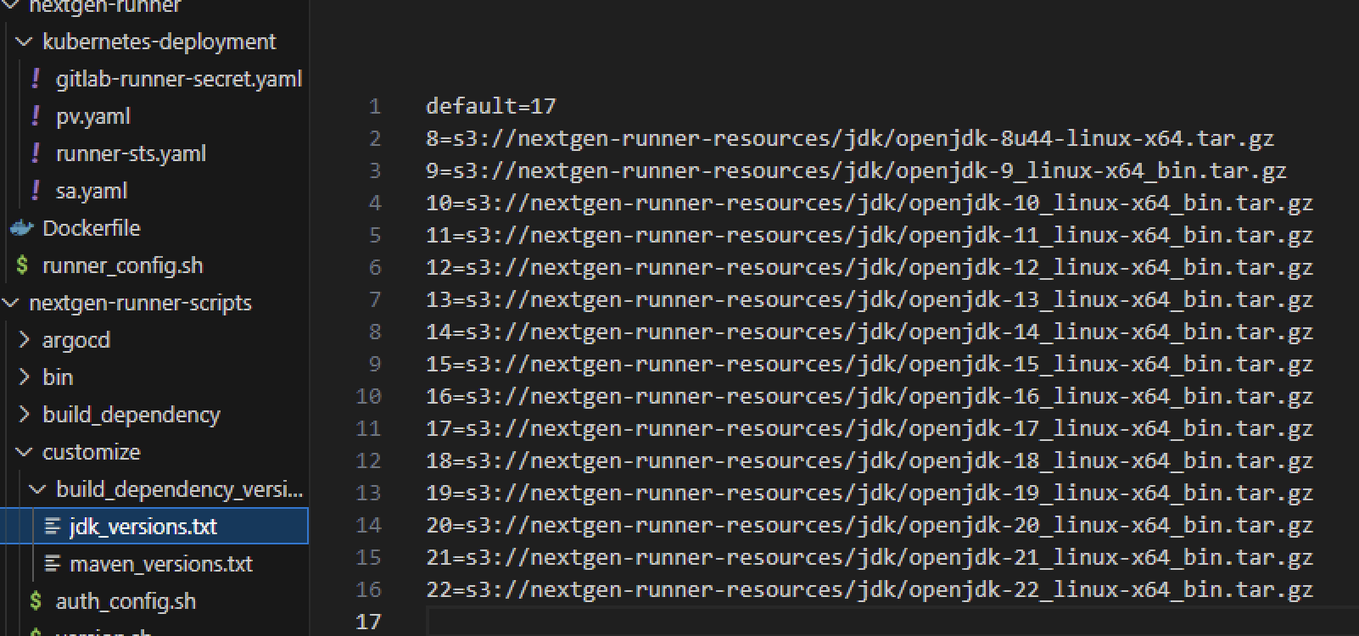





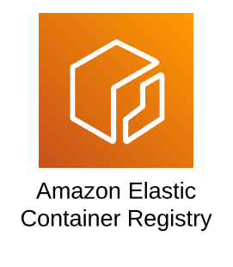
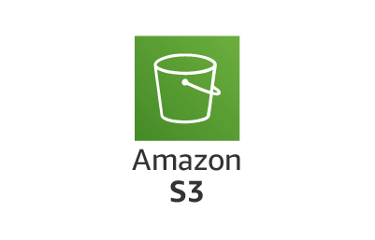
Development
DevOps
Platform Team
1
Framework user
2
Framework customization
3
Framework setup
Apply Gitlab Actions Templates
Adjust required variables
Select Build Version(JDK Version)
Namespce
BuildPath
Define Branching Strategy
Define Versioning Strategy
Customize the Build Tools & Versions if required
Maintain custom Runners
Setup ArgoCD
Setup Access to OCI Registry
Setup IAM Roles
Deploy Runner
Artifact builder
Build Tools Downloader
Repository Cache
- name: Do Build and Deploy
run: build_deploy
env:
NAMESPACE: epc
JDK_VERSION: 17
BUILD_PATH: BE
Docker Builder
Vulnerability Scanner
Auth Configurator
Helm Builder
Helm Templates
Build Version Manager
ArgoCD Builder
Repo Secret Auto generator
Certificate Installer
Custom Runner

Slide 12
Development
1
Framework user
Apply Gitlab Actions Templates
Adjust required variables
Select Build Version(JDK Version)
Namespce
BuildPath
Demo
Migrating a EPC microservice to our new CICD framework
NextGen
commercial-epc-booking
- name: Do Build and Deploy
run: build_deploy
env:
NAMESPACE: epc
JDK_VERSION: 17
BUILD_PATH: BE

Slide 13
Apply gitub Action & get it deployed
1
2
3
Create Repo
Apply Github Actions Workflow
Deploy to Cloud
Clone commercial-epc-booking

Slide 14
Demo

Slide 15
A Spring boot project CICD does the following
Github Action Triggers build
Download right JDK version
Download certificates and install
Do maven build
Download Jars from Nexus
Cache the Jars in local EFS Volume
1. Commit Code With a Dockerfile
Do Docker build
Do Vulnerability scanning
Download the Vulnerability db
Cache the vulnerability db
Login to OCI Registry
Create Repository in Registry
Tag & retag the image and push
Do Helm Build
Adjust all the custom variables
Update Git & pipleine details in chart
Create helm chart and save it artifacts folder
Login to OCI Registry
Push Helm Chart into OCI Registry
Create ArgoCD repository secret
Create Argocd application yaml
Update Git & pipleine details in application
Do Kubernetes deployment
Upload all the arifacts into the pipeline
Complete Build & Deployment

Slide 16

Tasks
Basic Requirements
Admin AMC
GitHub Repository (Ashu) Technical User
Single Node Cluster – FCP - with RWX PV
Container Registry – OCI ? (Ashu)
Confluence Location (Rashi)
DevOps CICD
Implement Github Workflows Template
Implement Github Actions
Implement Branching Runner <> Label
Implement Gitlab branch policies
Kafka Connector
CI
Define Docker Tagging Concept
Hello-world base image
Refactoring existing code
CD
ArgoCD
Argo images needed in reg
OpenId Roles
Helm Access
Teams (Nabeel) Notifications
Enable Ingress
Custom Runners -ubuntu-
SelfHosted Runner
Service Account
Registry Access
Scripts to do build & deploy
Docker - cli
DiD -rootless
Vulnerability scanning
Trivy
Kubectl
GitHub Action Runner
Code Quality
SonarQube (Rashi)
Check existing solution
Helm
Generic Helm Template
Secrets
Comprehensive Software Development and DevOps Practices
Jacoco (Nabeel)
Customizable Variables
Open JDK 17
Logging
Dynatrace
Code Coverage
Tracablity
Istio
Dora (Rashi) Dashboards
Prometheus
Grafana (Nabeel)
Maven
Curl
Optional: Software Architecture
12 Factor Methdology
Branching Stratergy
Centralized Configuration
Cloud – Utils Shared Lib
Git
runtime-deps 6.0
Microservice

Slide 17

GET THE FUTURE YOU WANT
capgemini.com

